Slide 1
Automatic Question Generation (AQG) Metrics
Yuye

Slide 2
Contents
Introduction
Answerability
Experiments
Conclusion

Slide 3
Contents
Introduction
Answerability
Experiments
Conclusion

Slide 4
Introduction
Automatic Question Generation (AQG) is the task of automatically generating questions from a given source (eg. a document, an image)
Example:

Slide 5
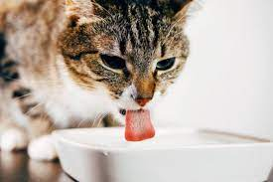
Introduction
Automatic Question Generation (AQG) is the task of automatically generating questions from a given source (eg. a document, an image)
Example:
What is the cat drinking?

Slide 6
Human Judgements
Relevance
Grammaticality
Specificity
Usefulness
Notes:
Is the question on topic?
Is the question grammatical?
How specific is the question?
How useful is the question to a potential buyer (or a current user) of the product?

Slide 7
Automatic Metrics
BLEU
METEOR
ROUGE
NIST
Diversity

Slide 8
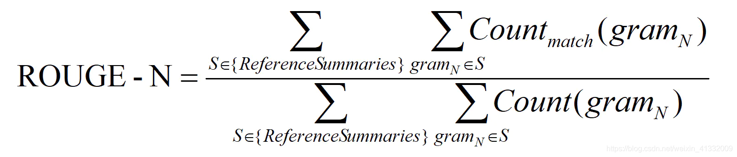
ROUGE-N
ROUGE-N: Overlap of n-grams between the system and reference.

Slide 9
ROUGE-N
ROUGE-N: Overlap of n-grams between the system and reference summaries.
Quiz: which sentence has higher ROUGE score with “Who was the director of Titanic?”
director of Titanic ?
Who was the director of ?

Slide 10
ROUGE-N
ROUGE-N: Overlap of n-grams between the system and reference summaries.
Quiz: which sentence has higher ROUGE score with “Who was the director of Titanic?”
director of Titanic?
Who was the director of?

Slide 11
ROUGE-N
ROUGE-N: Overlap of n-grams between the system and reference summaries.
Quiz: which sentence has higher ROUGE score with “Who was the director of Titanic?”
director of Titanic?
Who was the director of? (Better question)

Slide 12
Contents
Introduction
Answerability
Experiments
Conclusion

Slide 13
Answerability
Paper name: Towards a Better Metric for Evaluating Question Generation Systems (EMNLP 2018)
Definition: whether the question contains enough information for them to be able to answer it correctly
Create noisy questions from existing datasets and Human annotation

Slide 14
Create noisy questions
Three datasets: SQuAD, WikiMovies, and VQA
Dropping function words
Dropping Named Entities
Dropping Content Words
Changing the Question type

Slide 15
Create noisy questions
Dropping function words:
What globally popular half marathon began in 1981?
What globally popular half marathon began 1981?
Dropping Named Entities
Which films did Lee H. Katzin direct ?
-> Which films did direct ?

Slide 16
Create noisy questions
Dropping Content Words
Who killed Jane?
-> Who married Jane?
Changing the Question type
Who killed Jane?
->What killed Jane?

Slide 17
Human annotation
Rate the answerability of the above noisy questions on a scale of 1-5
1: All important information is missing and it is impossible to answer the question
2: Most of the important information is missing and I can’t infer the
answer to the question
3: Some important information is missing leading to multiple answers
4: Most of the important information is present and I can infer the answer
5: All important information is present and I can answer the question

Slide 18
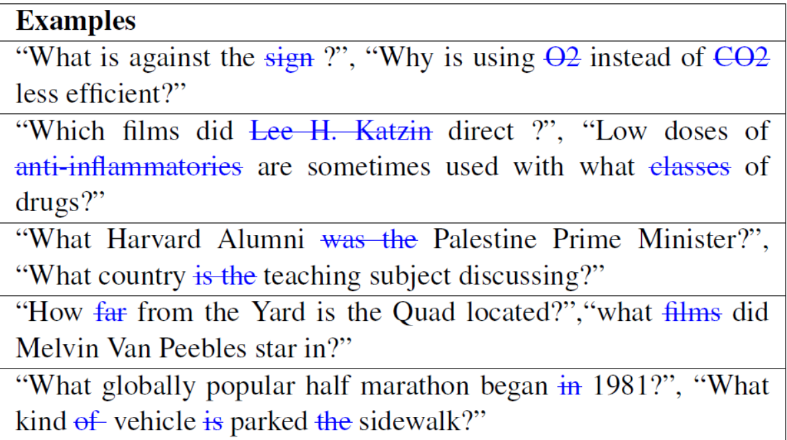
Human annotation
Rate the answerability of the above noisy questions on a scale of 1-5
1: All important information is missing and it is impossible to answer the question
2: Most of the important information is missing and I can’t infer the
answer to the question
3: Some important information is missing leading to multiple answers
4: Most of the important information is present and I can infer the answer
5: All important information is present and I can answer the question

Slide 19
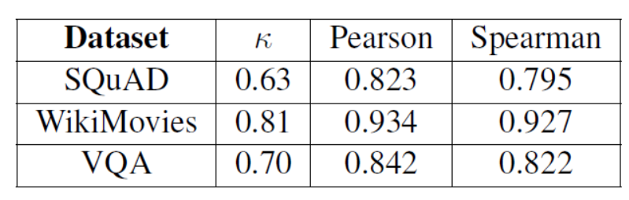
Inter annotator agreement
Cohen kappa, Pearson and Spearman

Slide 20
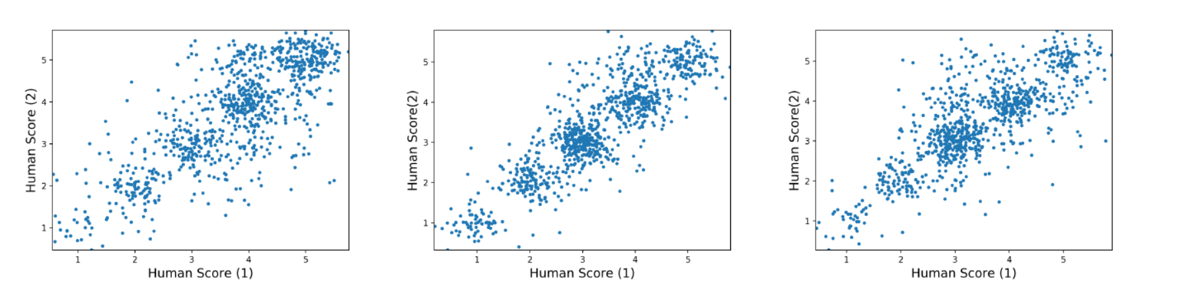
Inter annotator agreement

Slide 21
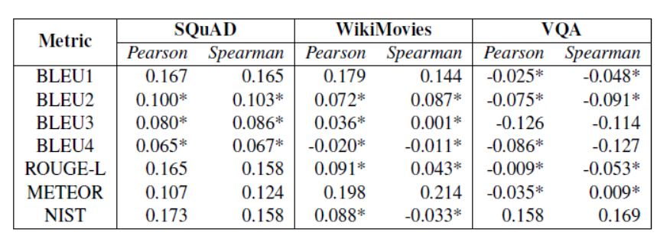
Existing metrics & human judgments
*: not statistically significant

Slide 22
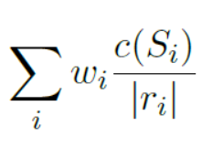
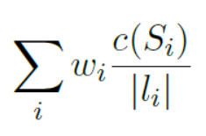
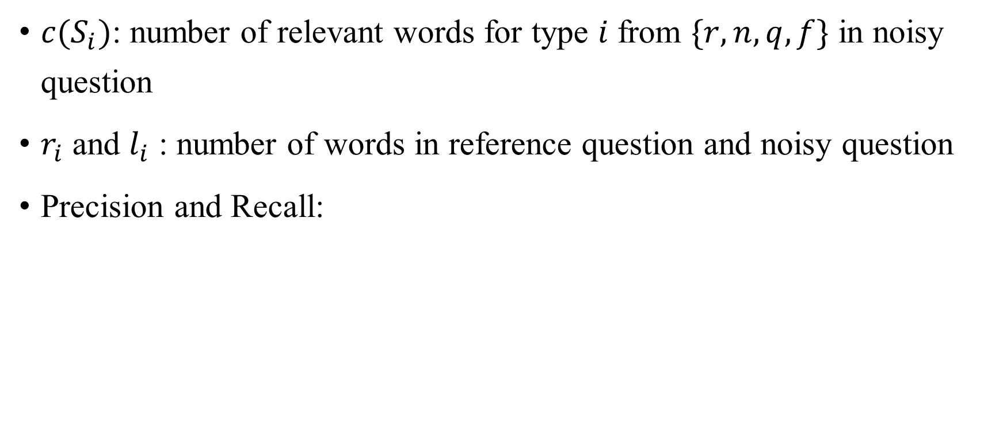
Definition of Answerability
$c(S_{i})$: number of relevant words for type $i$ from $\{r,n,q,f\}$ in noisy question
$r_{i}$ and $l_{i}$ : number of words in reference question and noisy question
Precision and Recall:

Slide 23
Definition of Answerability
$c(S_{i})$: number of relevant words for type $i$ from $\{r,n,q,f\}$ in noisy question
$r_{i}$ and $l_{i}$ : number of words in reference question and noisy question
Precision and Recall:
Quiz: which is precision/recall?
Notes:
Left one is precision

Slide 24
Definition of Answerability
$c(S_{i})$: number of relevant words for type $i$ from $\{r,n,q,f\}$ in noisy question
$r_{i}$ and $l_{i}$ : number of words in reference question and noisy question
Precision and Recall:
Quiz: Define Answerabiliy like F1:

Slide 25
Definition of Answerability
$c(S_{i})$: number of relevant words for type $i$ from $\{r,n,q,f\}$ in noisy question
$r_{i}$ and $l_{i}$ : number of words in reference question and noisy question
Precision and Recall:
Quiz: Define Answerabiliy like F1: 2 * P * R / (P + R)

Slide 26
Combine with other metrics
$c(S_{i})$: number of relevant words for type $i$ from $\{r,n,q,f\}$ in noisy question
$r_{i}$ and $l_{i}$ : number of words in reference question and noisy question
Precision and Recall:
Quiz: Define Answerabiliy like F1: 2 * P * R / (P + R)

Slide 27
Contents
Introduction
Answerability
Experiments
Conclusion

Slide 28
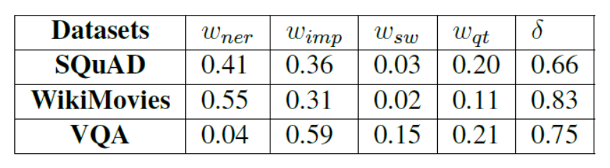
Weights

Slide 29
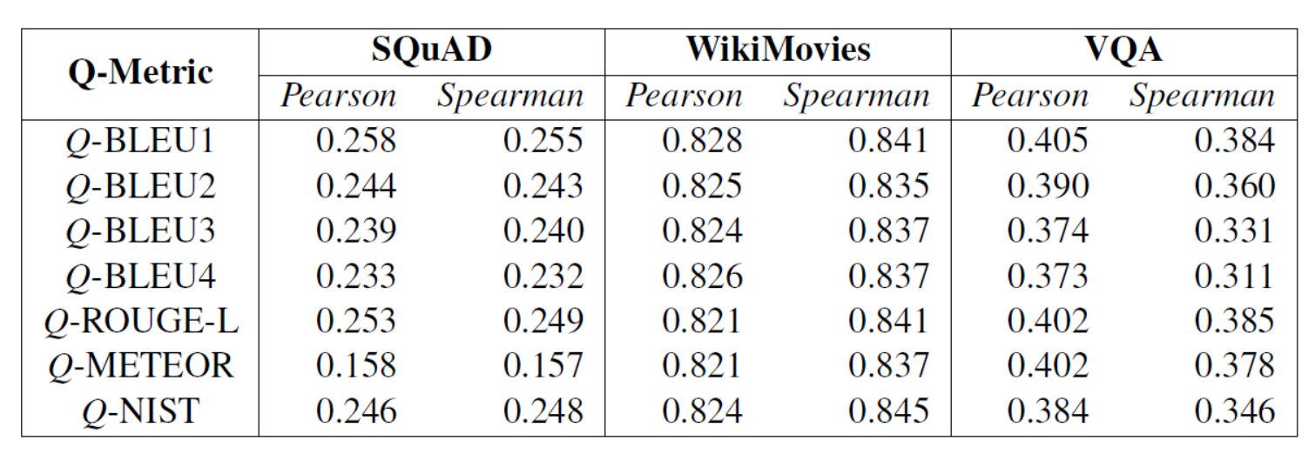
Correlation

Slide 30
Contents
Introduction
Automatic Metrics
Answerability
Conclusion

Slide 31
Conclusion
New metric: Answerability
Pros:
Convenient to compute
Better correlation with human
Can be combined to existing metrics
Drawback:
Need reference
Need to finetune weight

Slide 32
Q&A

